Slide 1
Linear Regression
Przemysław Sekuła
Based on ‘Machine Learning – Stanford’ by Andrew NG. Couse is available at: https://www.coursera.org/learn/machine-learning

Slide 2
Model

Slide 3
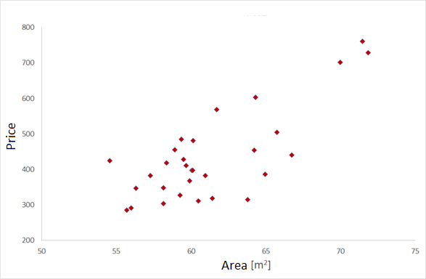
Dataset
Task: Given the dataset about apartments prepare the system capable of predicting apartment price
Question: Regression or Classification?

Slide 4
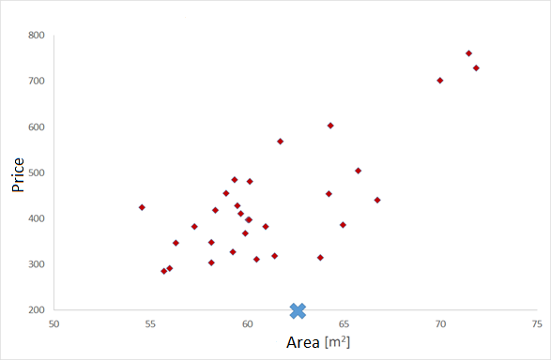
Regression
Task: Estimate the price of the 62,5 m² apartment

Slide 5
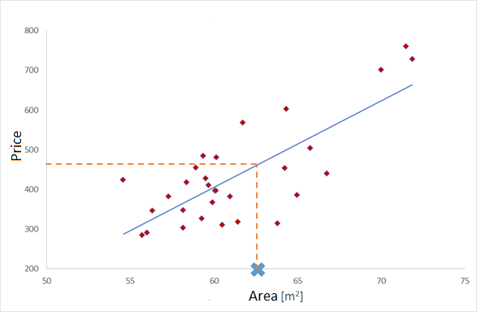
Regression
Task: Estimate the price of the 62,5 m² apartment

Slide 6
Notation
X (area) | Y (price)
65.75 | 504
64.21 | 453.6
71.85 | 728.7
69.98 | 701.4
71.47 | 760.2
X – inputs, features
Y – targets, labels
X→Y –training set
M –number of x →y pairs

Slide 7
Notation
X (area) | Y (price)
65.75 | 504
64.21 | 453.6
71.85 | 728.7
69.98 | 701.4
71.47 | 760.2
Dataset
Learning algorithm
Size of house
h
Predicted price

Slide 8
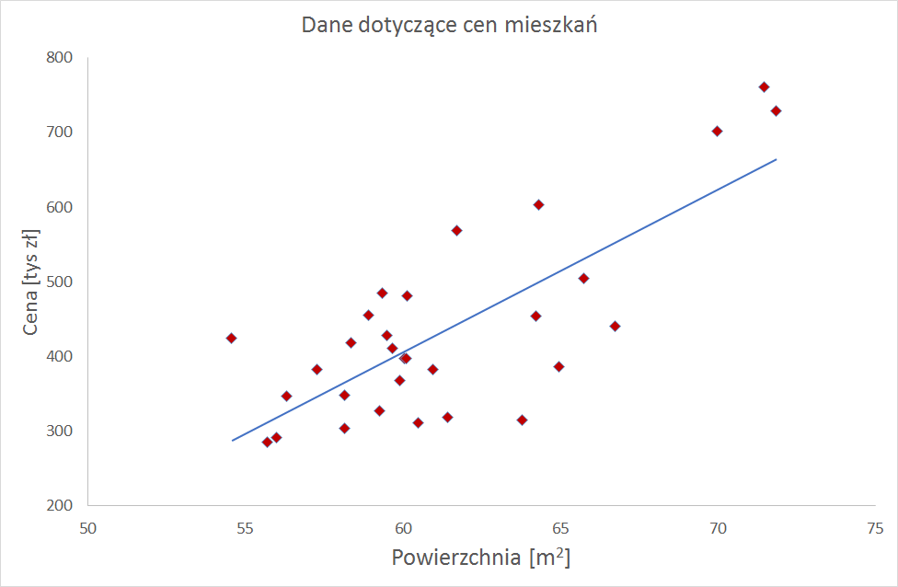
Model
How to denote h?
h_{Θ}(x)= Θ₀ + Θ₁x
Dataset
Learning algorithm
Size of house
h
Predicted price

Slide 9
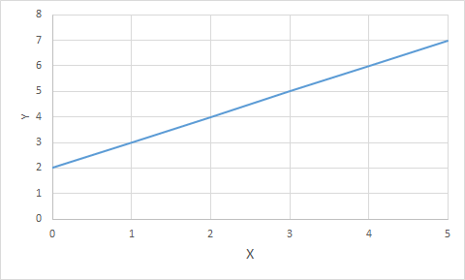
Quick Question
h_{Θ}(x)= Θ₀ + Θ₁x
Θ₀ = 0, Θ₁ = 1
Θ₀ = 1, Θ₁ = 0
Θ₀ = 2, Θ₁ = 2
Θ₀ = 2, Θ₁ = 1
Θ₀ = 1, Θ₁ = 2

Slide 10
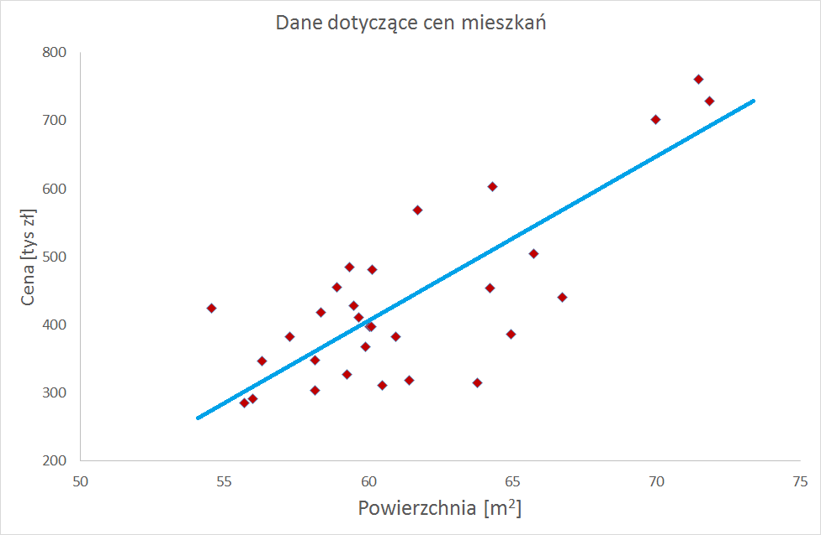
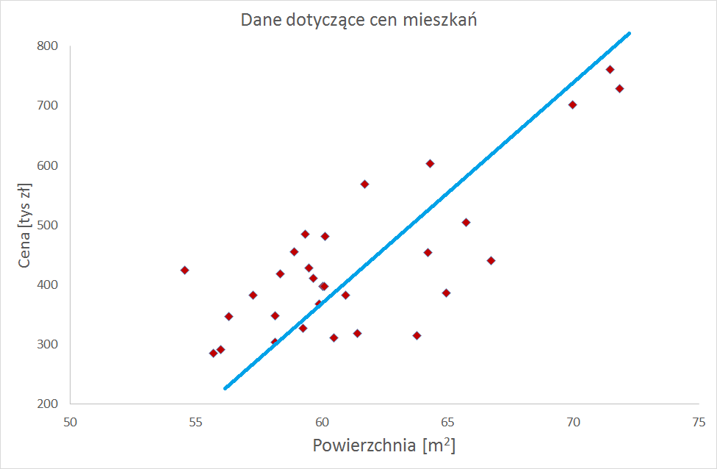
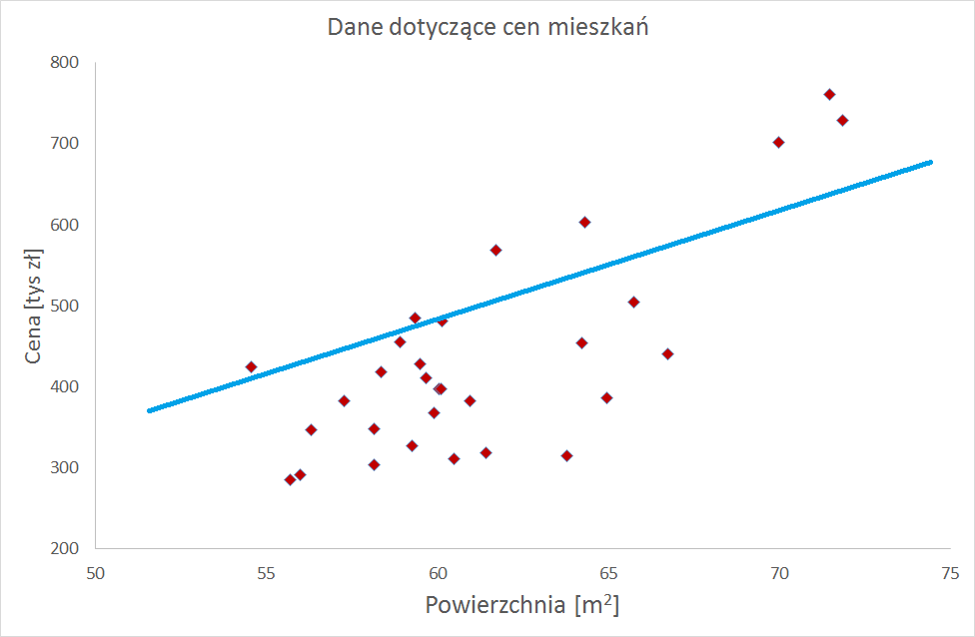
How to prepare the modeL
h_{Θ}(x)= Θ₀ + Θ₁x
Question: Which line gives us the best model?
How should we select Θ₀ i Θ₁?

Slide 11
Cost function

Slide 12
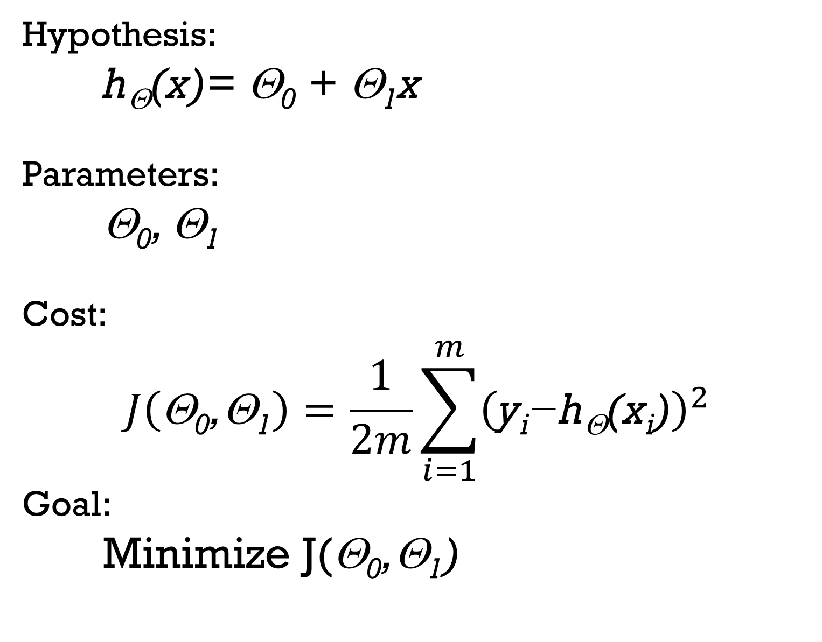
Hypothesis:
h_{Θ}(x)= Θ₀ + Θ₁x
Parameters:
Θ₀, Θ₁
Cost:
$$J\left(\text{Θ}\text{0}\text{,Θ}\text{1}\right)=\frac{1}{2m}\sum_{i=1}^{m}{{\left(\text{y}\text{i}\text{−}\text{h}\text{Θ}\text{(}\text{x}\text{i}\text{)}\right)}^{2}}$$
Goal:
Minimize J(Θ₀,Θ₁)

Slide 13
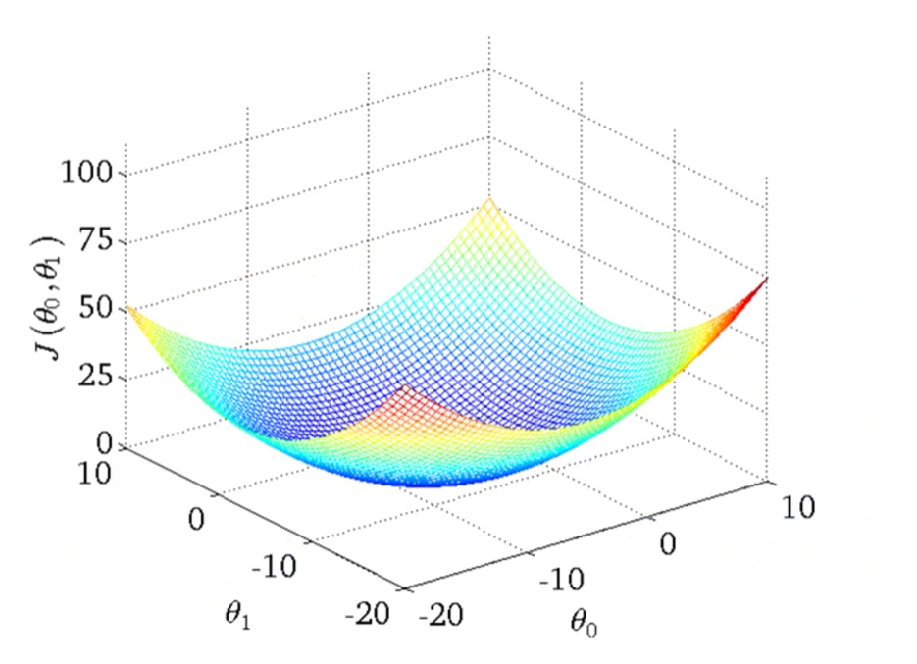
Cos function for 2 Parameters

Slide 14
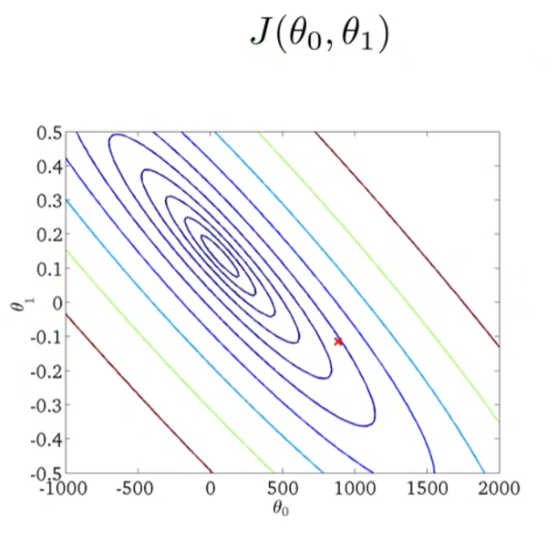
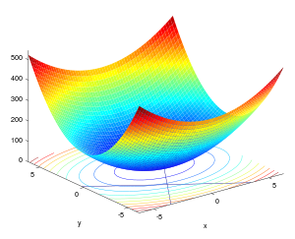
Contour Plot

Slide 15
Gradient Descent

Slide 16
Gradient Descent – Outline (1/2)
Given: J(Θ₀,Θ₁)
Goal: minimize J(Θ₀,Θ₁)
Algorithm:
Start with random Θ₀,Θ₁
Change Θ₀,Θ₁ gradually in order to minimize J(Θ₀,Θ₁)
Repeat point 2 until you reach minimum of cost function

Slide 17
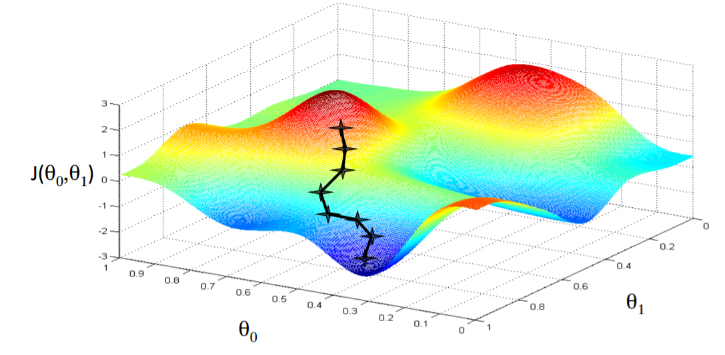
Gradient Descent – Outline (2/2)

Slide 18

Gradient Descent - algorIthm
For each Θ_{j} repeat
$$\text{}\text{j}≔\text{}\text{j}−α\frac{δ}{δ\text{}\text{j}}J\left(\text{}\text{0}\text{,}\text{1}\right)$$
Until the cost stops decreasing
cost:
$$J\left(\text{Θ}\text{0}\text{,Θ}\text{1}\right)=\frac{1}{2m}\sum_{i=1}^{m}{{\left(\text{h}\text{Θ}\text{(}\text{xi}\text{) −}\text{y}\text{i}\right)}^{2}}$$
(Θ₀ i Θ₁ are changed simultaneously)

Slide 19
Gradient Descent - Example
Coursera: Machine Learning – Stanford
Andrew NG
https://www.coursera.org/learn/machine-learning

Slide 20
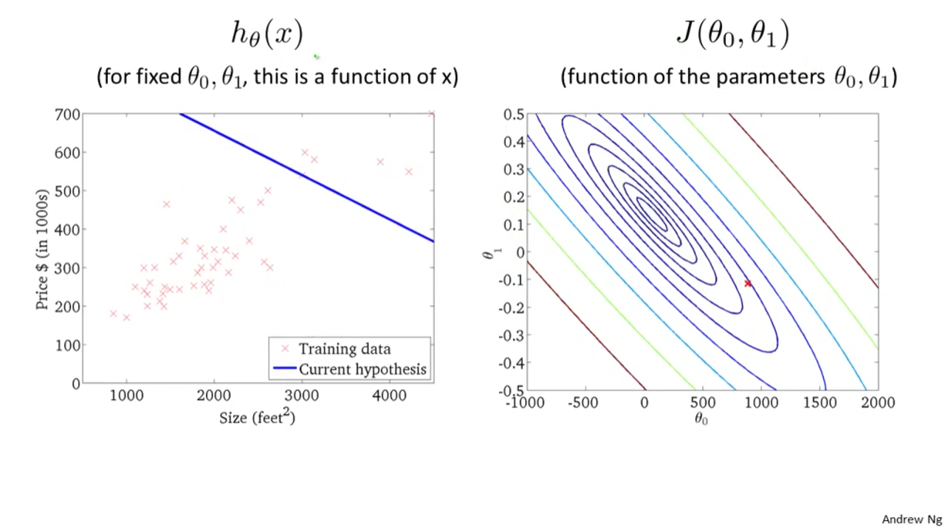

Slide 21
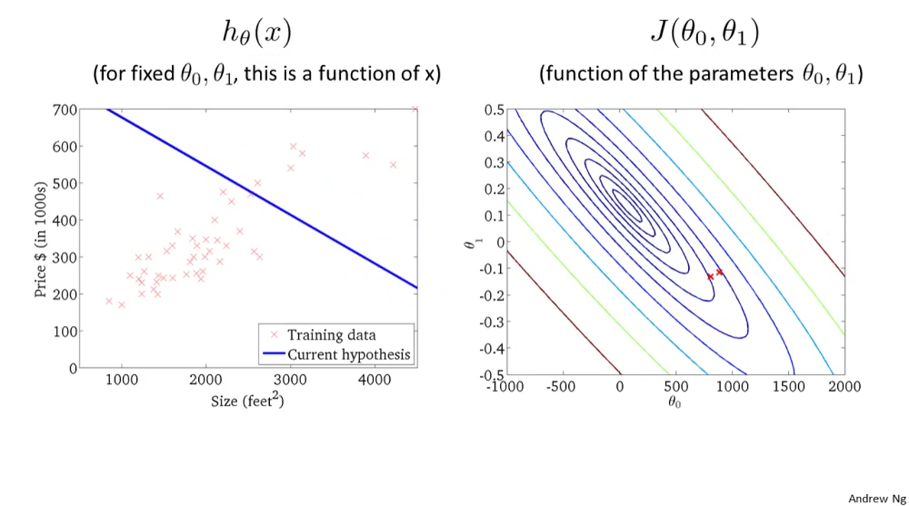

Slide 22
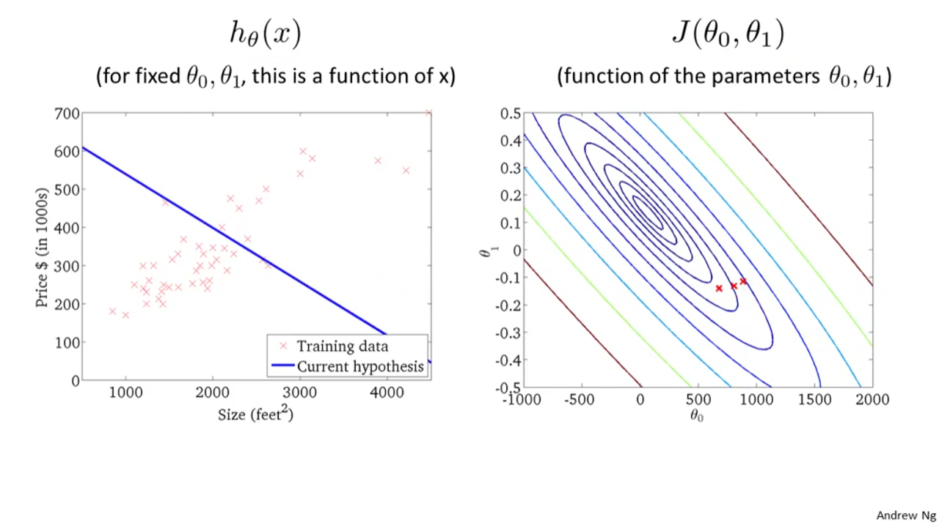

Slide 23
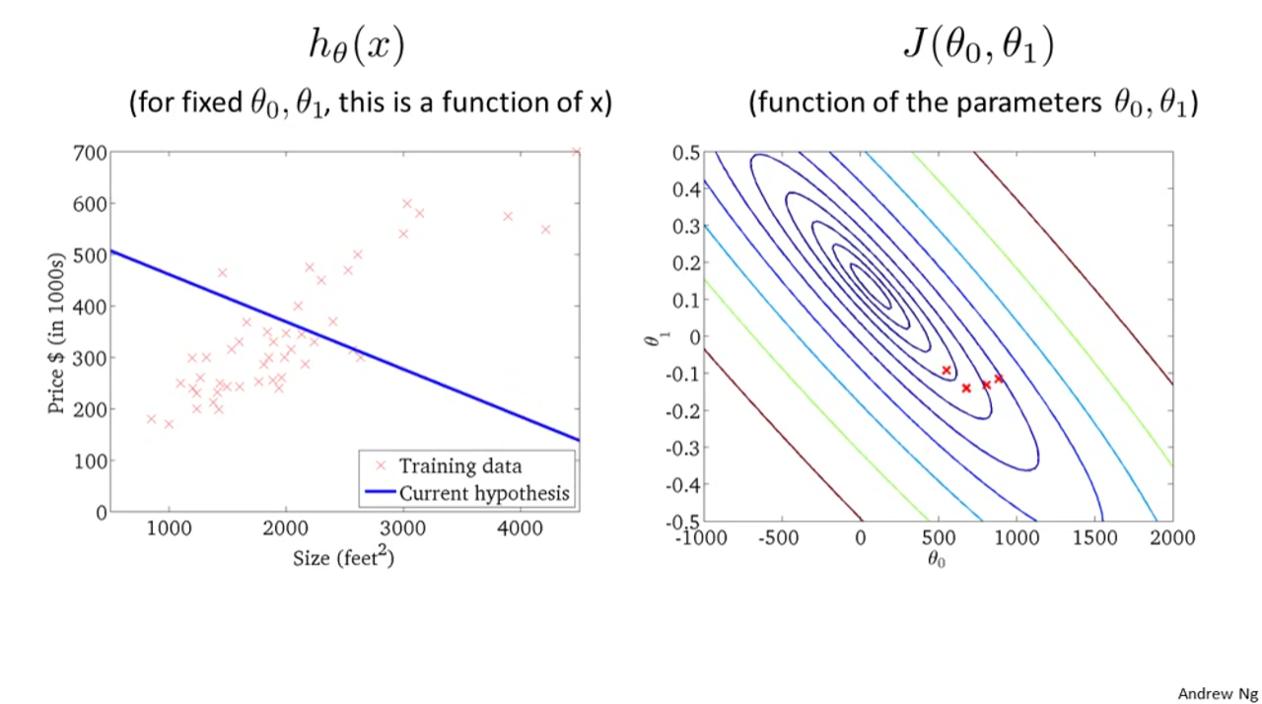

Slide 24
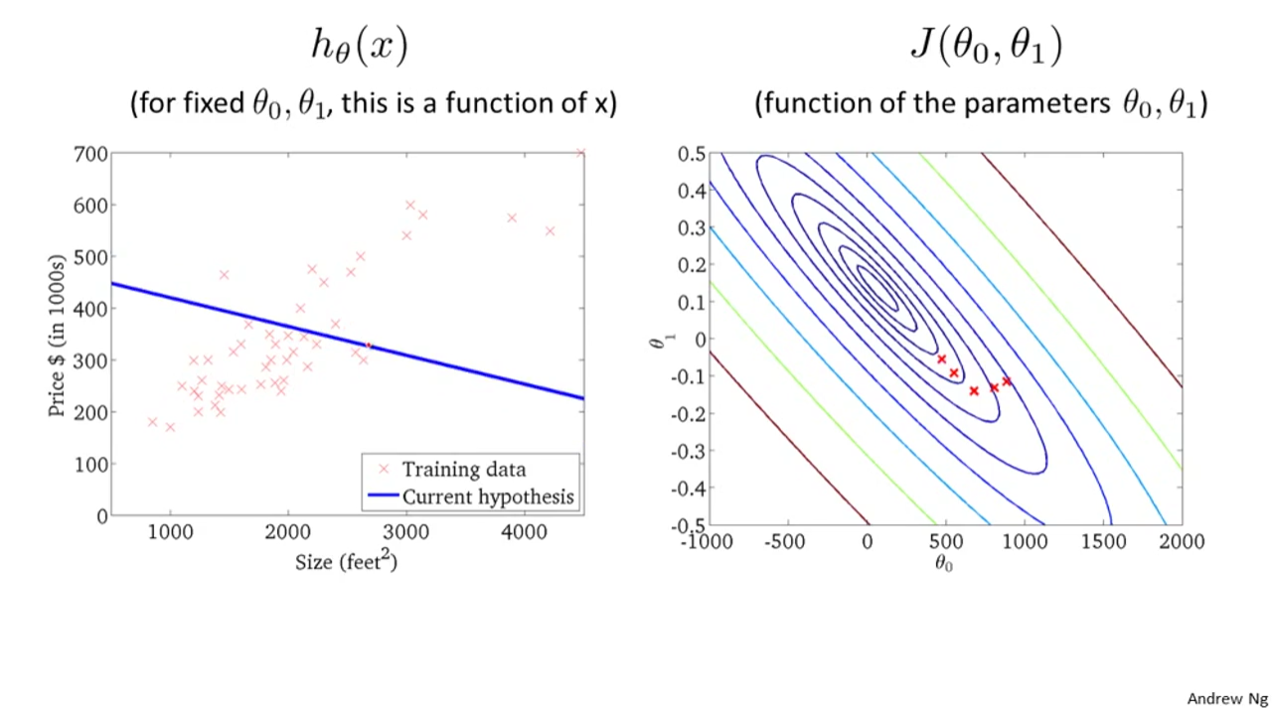

Slide 25
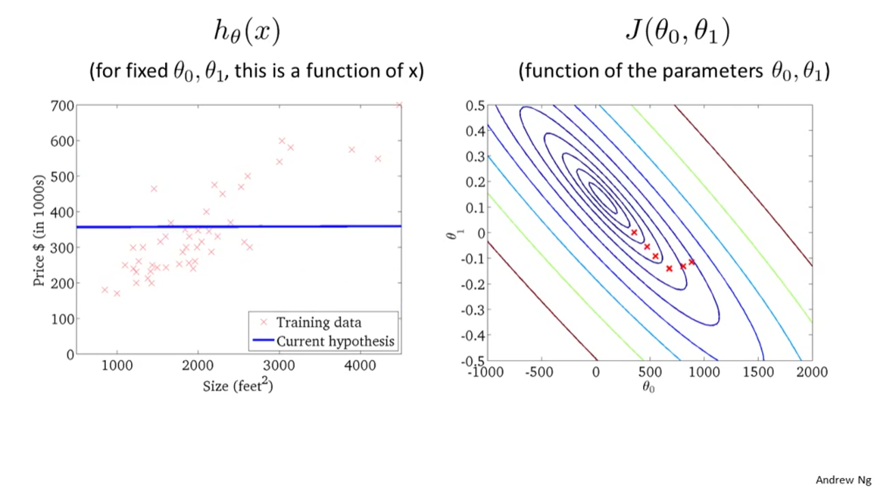

Slide 26
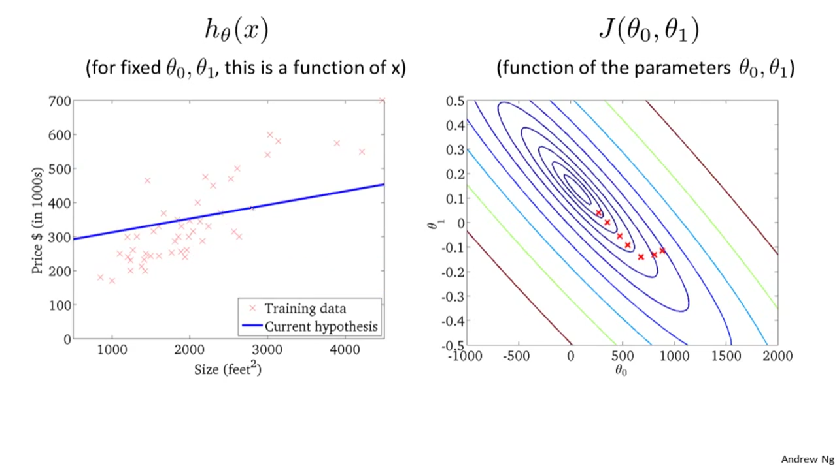

Slide 27
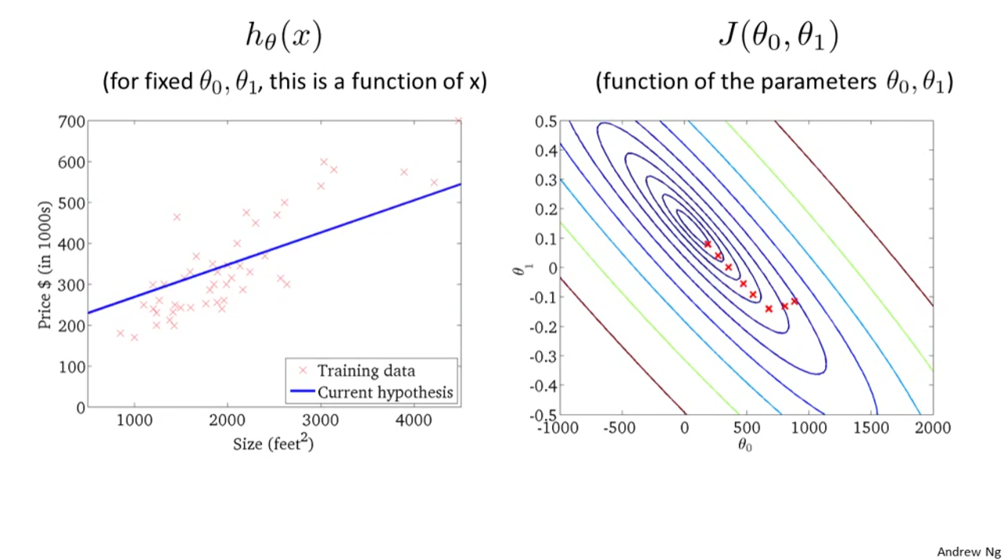

Slide 28
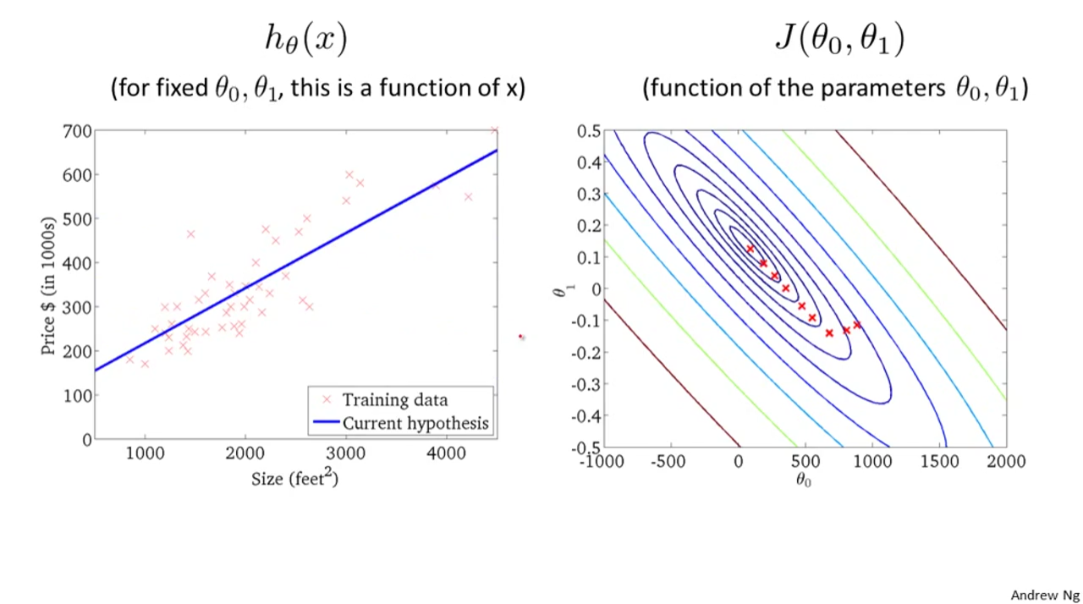

Slide 29
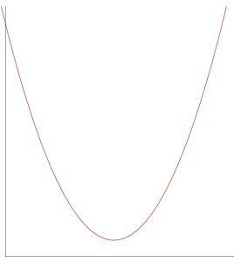
Gradient Descent – Length of the jump
Average jump
Small jump
Large jump

Slide 30
Gradient Descent – Computing Derivative

Slide 31


Computing Derivatives
$$Grad(J\left(\text{Θ}\text{0}\text{,}\text{Θ}\text{1}\right)=\left[\begin{matrix}\frac{δJ}{δ\text{Θ}\text{0}} \\ \frac{δJ}{δ\text{Θ}\text{1}}\end{matrix}\right]$$
Hypothesis:
h_{Θ}(x)= Θ₀ + Θ₁x
Parameters:
Θ₀, Θ₁
Cost:
$$J\left(\text{Θ}\text{0}\text{,Θ}\text{1}\right)=\frac{1}{2m}\sum_{i=1}^{m}{{\left(\text{y}\text{i}\text{−}\text{h}\text{Θ}\text{(}\text{x}\text{i}\text{)}\right)}^{2}}$$
Goal:
minimize J(Θ₀,Θ₁)

Slide 32
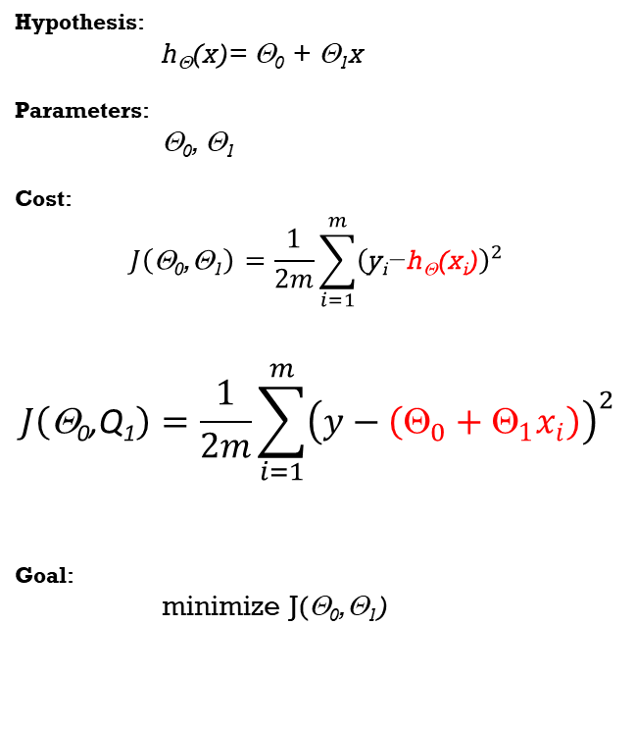
Computing Derivatives
$$Grad(J\left(\text{Θ}\text{0}\text{,}\text{Θ}\text{1}\right)=\left[\begin{matrix}\frac{δJ}{δ\text{Θ}\text{0}} \\ \frac{δJ}{δ\text{Θ}\text{1}}\end{matrix}\right]$$
Hypothesis:
h_{Θ}(x)= Θ₀ + Θ₁x
Parameters:
Θ₀, Θ₁
Cost:
$$J\left(\text{Θ}\text{0}\text{,Θ}\text{1}\right)=\frac{1}{2m}\sum_{i=1}^{m}{{\left(\text{y}\text{i}\text{−}\text{h}\text{Θ}\text{(}\text{x}\text{i}\text{)}\right)}^{2}}$$
$$J\left(\text{Θ}\text{0}\text{,}\text{Q}\text{1}\right)=\frac{1}{2m}\sum_{i=1}^{m}{{\left(y−\left(Θ_{0}+Θ_{1}x_{i}\right)\right)}^{2}}$$
Goal:
minimize J(Θ₀,Θ₁)

Slide 33
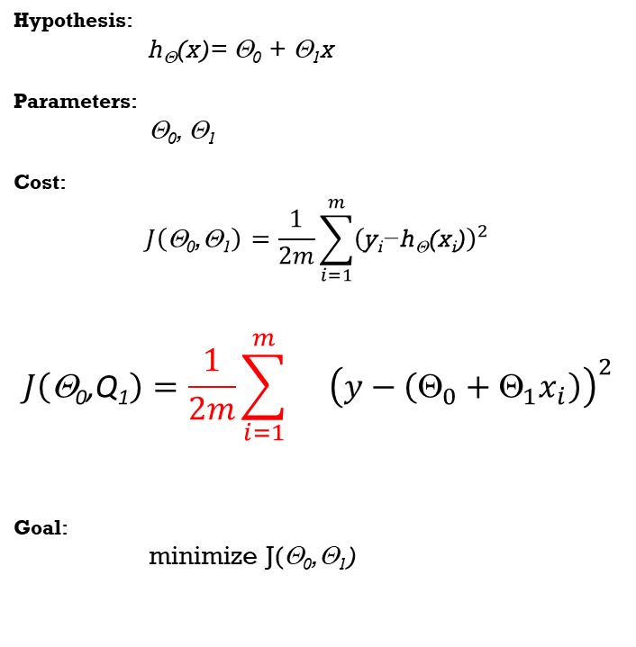

Computing Derivatives
$$Grad(J\left(\text{Θ}\text{0}\text{,}\text{Θ}\text{1}\right)=\left[\begin{matrix}\frac{δJ}{δ\text{Θ}\text{0}} \\ \frac{δJ}{δ\text{Θ}\text{1}}\end{matrix}\right]$$
$$\frac{δJ}{δ\text{Θ}\text{0}}=\frac{1}{2m}\sum_{i=1}^{m}{}\frac{δ}{δ\text{Θ}\text{0}}{\left(y−\left(Θ_{0}+Θ_{1}x_{i}\right)\right)}^{2}$$
Hypothesis:
h_{Θ}(x)= Θ₀ + Θ₁x
Parameters:
Θ₀, Θ₁
Cost:
$$J\left(\text{Θ}\text{0}\text{,Θ}\text{1}\right)=\frac{1}{2m}\sum_{i=1}^{m}{{\left(\text{y}\text{i}\text{−}\text{h}\text{Θ}\text{(}\text{x}\text{i}\text{)}\right)}^{2}}$$
$$J\left(\text{Θ}\text{0}\text{,}\text{Q}\text{1}\right)=\frac{1}{2m}\sum_{i=1}^{m}{}{\left(y−\left(Θ_{0}+Θ_{1}x_{i}\right)\right)}^{2}$$
Goal:
minimize J(Θ₀,Θ₁)

Slide 34
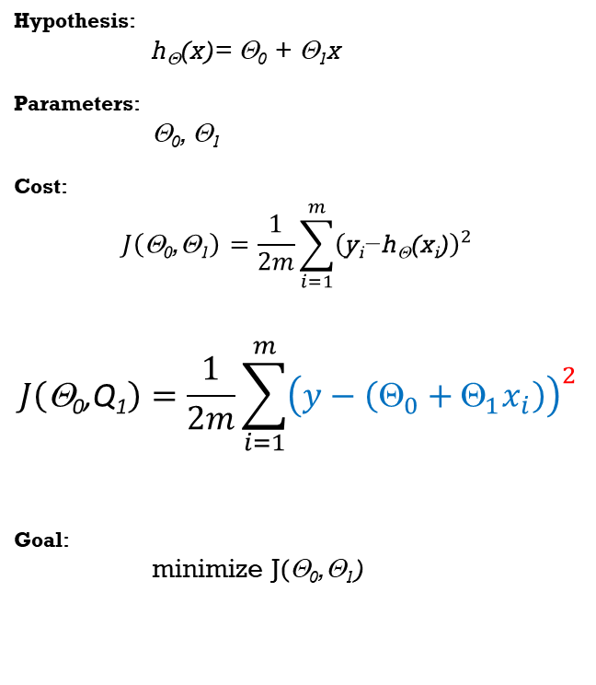

Computing Derivatives
$$Grad(J\left(\text{Θ}\text{0}\text{,}\text{Θ}\text{1}\right)=\left[\begin{matrix}\frac{δJ}{δ\text{Θ}\text{0}} \\ \frac{δJ}{δ\text{Θ}\text{1}}\end{matrix}\right]$$
$\frac{δJ}{δ\text{Θ}\text{0}}=2\frac{1}{2m}\sum_{i=1}^{m}{\left(y−\left(Θ_{0}+Θ_{1}x_{i}\right)\right)}$* $\frac{δ}{δ\text{Θ}\text{0}}$($y−\left(Θ_{0}+Θ_{1}x_{i}\right)$)
Hypothesis:
h_{Θ}(x)= Θ₀ + Θ₁x
Parameters:
Θ₀, Θ₁
Cost:
$$J\left(\text{Θ}\text{0}\text{,Θ}\text{1}\right)=\frac{1}{2m}\sum_{i=1}^{m}{{\left(\text{y}\text{i}\text{−}\text{h}\text{Θ}\text{(}\text{x}\text{i}\text{)}\right)}^{2}}$$
$$J\left(\text{Θ}\text{0}\text{,}\text{Q}\text{1}\right)=\frac{1}{2m}\sum_{i=1}^{m}{{\left(y−\left(Θ_{0}+Θ_{1}x_{i}\right)\right)}^{2}}$$
Goal:
minimize J(Θ₀,Θ₁)

Slide 35

Computing Derivatives
$$Grad(J\left(\text{Θ}\text{0}\text{,}\text{Θ}\text{1}\right)=\left[\begin{matrix}\frac{δJ}{δ\text{Θ}\text{0}} \\ \frac{δJ}{δ\text{Θ}\text{1}}\end{matrix}\right]$$
$\frac{δJ}{δ\text{Θ}\text{0}}=2\frac{1}{2m}\sum_{i=1}^{m}{\left(y−\left(Θ_{0}+Θ_{1}x_{i}\right)\right)}$* $\frac{δ}{δ\text{Θ}\text{0}}$($y−\left(Θ_{0}+Θ_{1}x_{i}\right)$)
$$\frac{δJ}{δ\text{Θ}\text{0}}=2\frac{1}{2m}\sum_{i=1}^{m}{\left(y−\left(Θ_{0}+Θ_{1}x_{i}\right)\right)∗\left(0−\left(..+..\right) \right)}$$
Hypothesis:
h_{Θ}(x)= Θ₀ + Θ₁x
Parameters:
Θ₀, Θ₁
Cost:
$$J\left(\text{Θ}\text{0}\text{,Θ}\text{1}\right)=\frac{1}{2m}\sum_{i=1}^{m}{{\left(\text{y}\text{i}\text{−}\text{h}\text{Θ}\text{(}\text{x}\text{i}\text{)}\right)}^{2}}$$
$$J\left(\text{Θ}\text{0}\text{,}\text{Q}\text{1}\right)=\frac{1}{2m}\sum_{i=1}^{m}{{\left(y−\left(Θ_{0}+Θ_{1}x_{i}\right)\right)}^{2}}$$
Goal:
minimize J(Θ₀,Θ₁)

Slide 36

Computing Derivatives
$$Grad(J\left(\text{Θ}\text{0}\text{,}\text{Θ}\text{1}\right)=\left[\begin{matrix}\frac{δJ}{δ\text{Θ}\text{0}} \\ \frac{δJ}{δ\text{Θ}\text{1}}\end{matrix}\right]$$
$\frac{δJ}{δ\text{Θ}\text{0}}=2\frac{1}{2m}\sum_{i=1}^{m}{\left(y−\left(Θ_{0}+Θ_{1}x_{i}\right)\right)}$* $\frac{δ}{δ\text{Θ}\text{0}}$($y−\left(Θ_{0}+Θ_{1}x_{i}\right)$)
$$\frac{δJ}{δ\text{Θ}\text{0}}=2\frac{1}{2m}\sum_{i=1}^{m}{\left(y−\left(Θ_{0}+Θ_{1}x_{i}\right)\right)∗\left(0−\left(1+..\right) \right)}$$
Hypothesis:
h_{Θ}(x)= Θ₀ + Θ₁x
Parameters:
Θ₀, Θ₁
Cost:
$$J\left(\text{Θ}\text{0}\text{,Θ}\text{1}\right)=\frac{1}{2m}\sum_{i=1}^{m}{{\left(\text{y}\text{i}\text{−}\text{h}\text{Θ}\text{(}\text{x}\text{i}\text{)}\right)}^{2}}$$
$$J\left(\text{Θ}\text{0}\text{,}\text{Q}\text{1}\right)=\frac{1}{2m}\sum_{i=1}^{m}{{\left(y−\left(Θ_{0}+Θ_{1}x_{i}\right)\right)}^{2}}$$
Goal:
minimize J(Θ₀,Θ₁)

Slide 37

Computing Derivatives
$$Grad(J\left(\text{Θ}\text{0}\text{,}\text{Θ}\text{1}\right)=\left[\begin{matrix}\frac{δJ}{δ\text{Θ}\text{0}} \\ \frac{δJ}{δ\text{Θ}\text{1}}\end{matrix}\right]$$
$\frac{δJ}{δ\text{Θ}\text{0}}=2\frac{1}{2m}\sum_{i=1}^{m}{\left(y−\left(Θ_{0}+Θ_{1}x_{i}\right)\right)}$* $\frac{δ}{δ\text{Θ}\text{0}}$($y−\left(Θ_{0}+Θ_{1}x_{i}\right)$)
$$\frac{δJ}{δ\text{Θ}\text{0}}=2\frac{1}{2m}\sum_{i=1}^{m}{\left(y−\left(Θ_{0}+Θ_{1}x_{i}\right)\right)∗\left(0−\left(1+0\right) \right)}$$
Hypothesis:
h_{Θ}(x)= Θ₀ + Θ₁x
Parameters:
Θ₀, Θ₁
Cost:
$$J\left(\text{Θ}\text{0}\text{,Θ}\text{1}\right)=\frac{1}{2m}\sum_{i=1}^{m}{{\left(\text{y}\text{i}\text{−}\text{h}\text{Θ}\text{(}\text{x}\text{i}\text{)}\right)}^{2}}$$
$$J\left(\text{Θ}\text{0}\text{,}\text{Q}\text{1}\right)=\frac{1}{2m}\sum_{i=1}^{m}{{\left(y−\left(Θ_{0}+Θ_{1}x_{i}\right)\right)}^{2}}$$
Goal:
minimize J(Θ₀,Θ₁)

Slide 38
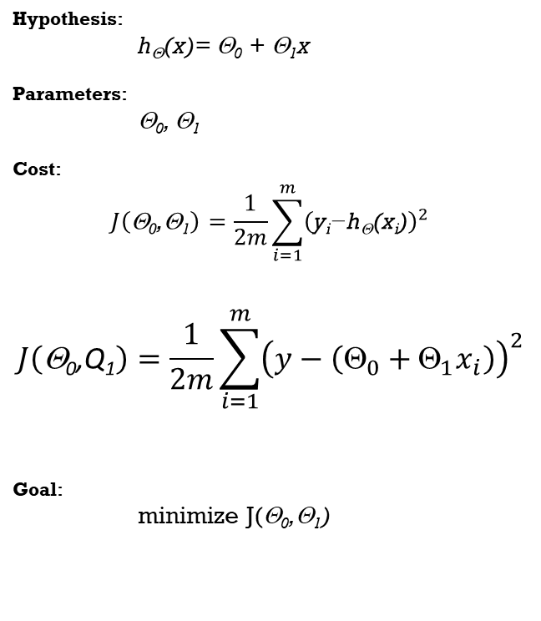

Computing Derivatives
$$Grad(J\left(\text{Θ}\text{0}\text{,}\text{Θ}\text{1}\right)=\left[\begin{matrix}\frac{δJ}{δ\text{Θ}\text{0}} \\ \frac{δJ}{δ\text{Θ}\text{1}}\end{matrix}\right]$$
$$\frac{δJ}{δ\text{Θ}\text{0}}=2\frac{1}{2m}\sum_{i=1}^{m}{\left(y−\left(Θ_{0}+Θ_{1}x_{i}\right)\right)∗\left(0−\left(1+0\right) \right)}$$
$$\frac{δJ}{δ\text{Θ}\text{0}}=2\frac{1}{2m}\sum_{i=1}^{m}{\left(y−\left(Θ_{0}+Θ_{1}x_{i}\right)\right)∗\left(−1 \right)}$$
Hypothesis:
h_{Θ}(x)= Θ₀ + Θ₁x
Parameters:
Θ₀, Θ₁
Cost:
$$J\left(\text{Θ}\text{0}\text{,Θ}\text{1}\right)=\frac{1}{2m}\sum_{i=1}^{m}{{\left(\text{y}\text{i}\text{−}\text{h}\text{Θ}\text{(}\text{x}\text{i}\text{)}\right)}^{2}}$$
$$J\left(\text{Θ}\text{0}\text{,}\text{Q}\text{1}\right)=\frac{1}{2m}\sum_{i=1}^{m}{{\left(y−\left(Θ_{0}+Θ_{1}x_{i}\right)\right)}^{2}}$$
Goal:
minimize J(Θ₀,Θ₁)

Slide 39

Computing Derivatives
$$Grad(J\left(\text{Θ}\text{0}\text{,}\text{Θ}\text{1}\right)=\left[\begin{matrix}\frac{δJ}{δ\text{Θ}\text{0}} \\ \frac{δJ}{δ\text{Θ}\text{1}}\end{matrix}\right]$$
$$\frac{δJ}{δ\text{Θ}\text{0}}=2\frac{1}{2m}\sum_{i=1}^{m}{\left(y−\left(Θ_{0}+Θ_{1}x_{i}\right)\right)∗\left(0−\left(1+0\right) \right)}$$
$$\frac{δJ}{δ\text{Θ}\text{0}}=2\frac{1}{2m}\sum_{i=1}^{m}{\left(y−\left(Θ_{0}+Θ_{1}x_{i}\right)\right)∗\left(−1 \right)}$$
$$\frac{δJ}{δ\text{Θ}\text{0}}=−\frac{1}{m}\sum_{i=1}^{m}{\left(y−\left(Θ_{0}+Θ_{1}x_{i}\right)\right)}$$
Hypothesis:
h_{Θ}(x)= Θ₀ + Θ₁x
Parameters:
Θ₀, Θ₁
Cost:
$$J\left(\text{Θ}\text{0}\text{,Θ}\text{1}\right)=\frac{1}{2m}\sum_{i=1}^{m}{{\left(\text{y}\text{i}\text{−}\text{h}\text{Θ}\text{(}\text{x}\text{i}\text{)}\right)}^{2}}$$
$$J\left(\text{Θ}\text{0}\text{,}\text{Q}\text{1}\right)=\frac{1}{2m}\sum_{i=1}^{m}{{\left(y−\left(Θ_{0}+Θ_{1}x_{i}\right)\right)}^{2}}$$
Goal:
minimize J(Θ₀,Θ₁)

Slide 40
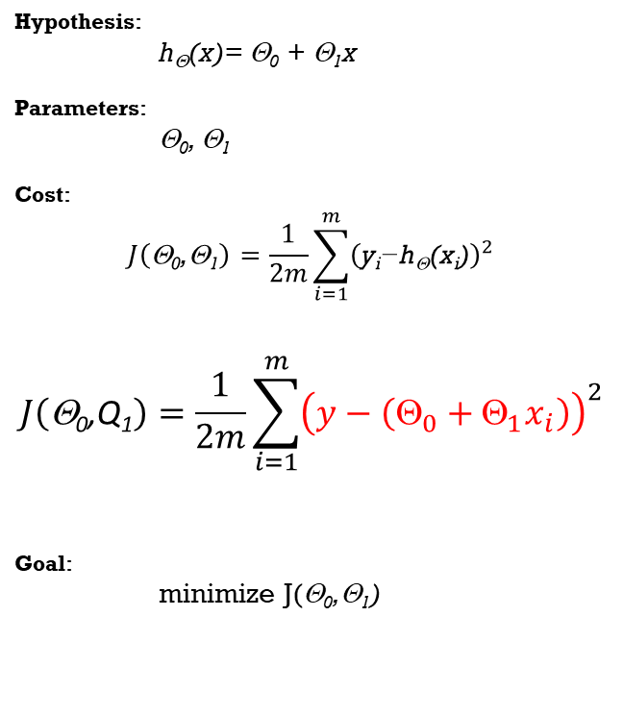
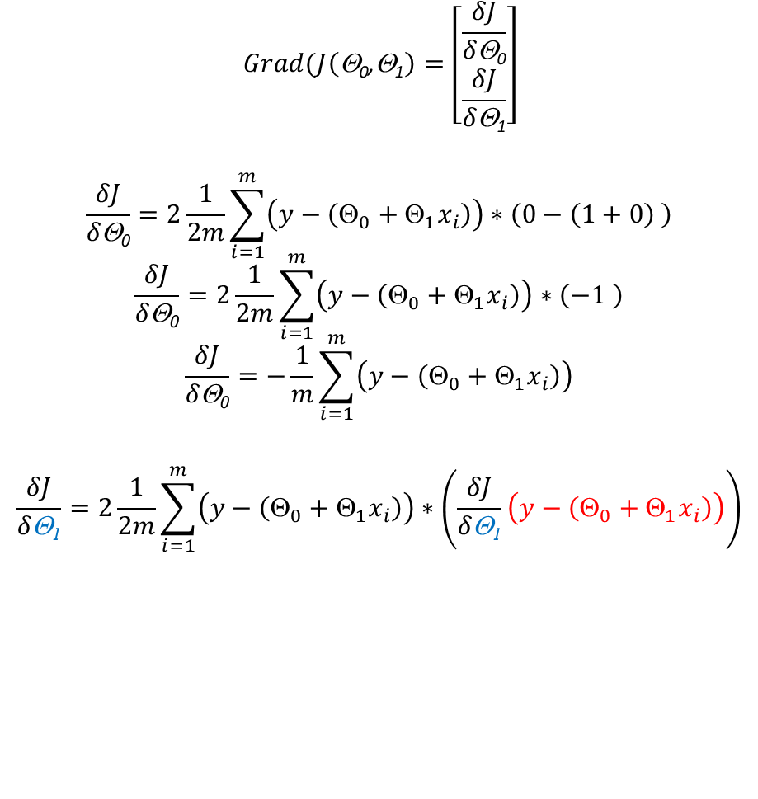
Computing Derivatives
$$Grad(J\left(\text{Θ}\text{0}\text{,}\text{Θ}\text{1}\right)=\left[\begin{matrix}\frac{δJ}{δ\text{Θ}\text{0}} \\ \frac{δJ}{δ\text{Θ}\text{1}}\end{matrix}\right]$$
$$\frac{δJ}{δ\text{Θ}\text{0}}=2\frac{1}{2m}\sum_{i=1}^{m}{\left(y−\left(Θ_{0}+Θ_{1}x_{i}\right)\right)∗\left(0−\left(1+0\right) \right)}$$
$$\frac{δJ}{δ\text{Θ}\text{0}}=2\frac{1}{2m}\sum_{i=1}^{m}{\left(y−\left(Θ_{0}+Θ_{1}x_{i}\right)\right)∗\left(−1 \right)}$$
$$\frac{δJ}{δ\text{Θ}\text{0}}=−\frac{1}{m}\sum_{i=1}^{m}{\left(y−\left(Θ_{0}+Θ_{1}x_{i}\right)\right)}$$
$$\frac{δJ}{δ\text{}\text{1}}=2\frac{1}{2m}\sum_{i=1}^{m}{\left(y−\left(_{0}+_{1}x_{i}\right)\right)∗\left(\frac{δJ}{δ\text{}\text{1}}\left(y−\left(_{0}+_{1}x_{i}\right)\right)\right)}$$
Hypothesis:
h_{Θ}(x)= Θ₀ + Θ₁x
Parameters:
Θ₀, Θ₁
Cost:
$$J\left(\text{Θ}\text{0}\text{,Θ}\text{1}\right)=\frac{1}{2m}\sum_{i=1}^{m}{{\left(\text{y}\text{i}\text{−}\text{h}\text{Θ}\text{(}\text{x}\text{i}\text{)}\right)}^{2}}$$
$$J\left(\text{Θ}\text{0}\text{,}\text{Q}\text{1}\right)=\frac{1}{2m}\sum_{i=1}^{m}{{\left(y−\left(Θ_{0}+Θ_{1}x_{i}\right)\right)}^{2}}$$
Goal:
minimize J(Θ₀,Θ₁)

Slide 41
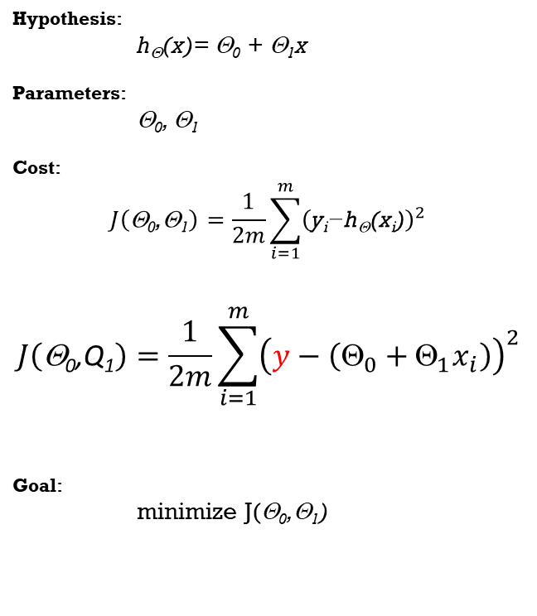

Computing Derivatives
$$Grad(J\left(\text{Θ}\text{0}\text{,}\text{Θ}\text{1}\right)=\left[\begin{matrix}\frac{δJ}{δ\text{Θ}\text{0}} \\ \frac{δJ}{δ\text{Θ}\text{1}}\end{matrix}\right]$$
$$\frac{δJ}{δ\text{Θ}\text{0}}=2\frac{1}{2m}\sum_{i=1}^{m}{\left(y−\left(Θ_{0}+Θ_{1}x_{i}\right)\right)∗\left(0−\left(1+0\right) \right)}$$
$$\frac{δJ}{δ\text{Θ}\text{0}}=2\frac{1}{2m}\sum_{i=1}^{m}{\left(y−\left(Θ_{0}+Θ_{1}x_{i}\right)\right)∗\left(−1 \right)}$$
$$\frac{δJ}{δ\text{Θ}\text{0}}=−\frac{1}{m}\sum_{i=1}^{m}{\left(y−\left(Θ_{0}+Θ_{1}x_{i}\right)\right)}$$
$$\frac{δJ}{δ\text{Θ}\text{1}}=2\frac{1}{2m}\sum_{i=1}^{m}{\left(y−\left(Θ_{0}+Θ_{1}x_{i}\right)\right)∗\left(0−\left(..+..\right) \right)}$$
Hypothesis:
h_{Θ}(x)= Θ₀ + Θ₁x
Parameters:
Θ₀, Θ₁
Cost:
$$J\left(\text{Θ}\text{0}\text{,Θ}\text{1}\right)=\frac{1}{2m}\sum_{i=1}^{m}{{\left(\text{y}\text{i}\text{−}\text{h}\text{Θ}\text{(}\text{x}\text{i}\text{)}\right)}^{2}}$$
$$J\left(\text{Θ}\text{0}\text{,}\text{Q}\text{1}\right)=\frac{1}{2m}\sum_{i=1}^{m}{{\left(y−\left(Θ_{0}+Θ_{1}x_{i}\right)\right)}^{2}}$$
Goal:
minimize J(Θ₀,Θ₁)

Slide 42
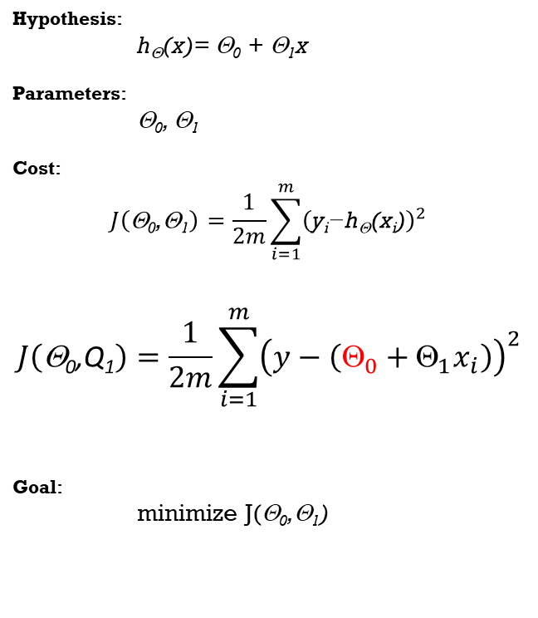

Computing Derivatives
$$Grad(J\left(\text{Θ}\text{0}\text{,}\text{Θ}\text{1}\right)=\left[\begin{matrix}\frac{δJ}{δ\text{Θ}\text{0}} \\ \frac{δJ}{δ\text{Θ}\text{1}}\end{matrix}\right]$$
$$\frac{δJ}{δ\text{Θ}\text{0}}=2\frac{1}{2m}\sum_{i=1}^{m}{\left(y−\left(Θ_{0}+Θ_{1}x_{i}\right)\right)∗\left(0−\left(1+0\right) \right)}$$
$$\frac{δJ}{δ\text{Θ}\text{0}}=2\frac{1}{2m}\sum_{i=1}^{m}{\left(y−\left(Θ_{0}+Θ_{1}x_{i}\right)\right)∗\left(−1 \right)}$$
$$\frac{δJ}{δ\text{Θ}\text{0}}=−\frac{1}{m}\sum_{i=1}^{m}{\left(y−\left(Θ_{0}+Θ_{1}x_{i}\right)\right)}$$
$$\frac{δJ}{δ\text{Θ}\text{1}}=2\frac{1}{2m}\sum_{i=1}^{m}{\left(y−\left(Θ_{0}+Θ_{1}x_{i}\right)\right)∗\left(0−\left(0 + ..\right) \right)}$$
Hypothesis:
h_{Θ}(x)= Θ₀ + Θ₁x
Parameters:
Θ₀, Θ₁
Cost:
$$J\left(\text{Θ}\text{0}\text{,Θ}\text{1}\right)=\frac{1}{2m}\sum_{i=1}^{m}{{\left(\text{y}\text{i}\text{−}\text{h}\text{Θ}\text{(}\text{x}\text{i}\text{)}\right)}^{2}}$$
$$J\left(\text{Θ}\text{0}\text{,}\text{Q}\text{1}\right)=\frac{1}{2m}\sum_{i=1}^{m}{{\left(y−\left(Θ_{0}+Θ_{1}x_{i}\right)\right)}^{2}}$$
Goal:
minimize J(Θ₀,Θ₁)

Slide 43
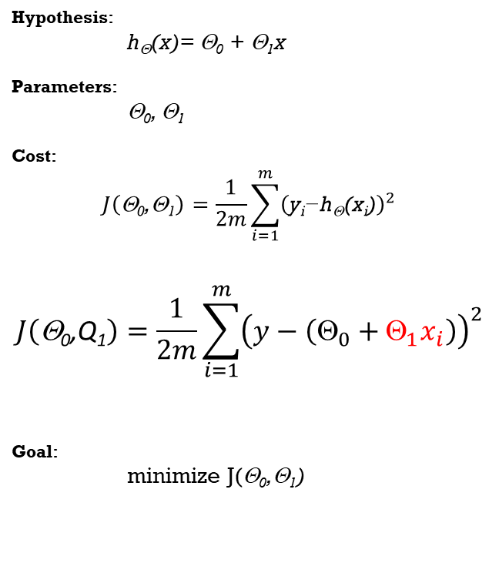

Computing Derivatives
$$Grad(J\left(\text{Θ}\text{0}\text{,}\text{Θ}\text{1}\right)=\left[\begin{matrix}\frac{δJ}{δ\text{Θ}\text{0}} \\ \frac{δJ}{δ\text{Θ}\text{1}}\end{matrix}\right]$$
$$\frac{δJ}{δ\text{Θ}\text{0}}=2\frac{1}{2m}\sum_{i=1}^{m}{\left(y−\left(Θ_{0}+Θ_{1}x_{i}\right)\right)∗\left(0−\left(1+0\right) \right)}$$
$$\frac{δJ}{δ\text{Θ}\text{0}}=2\frac{1}{2m}\sum_{i=1}^{m}{\left(y−\left(Θ_{0}+Θ_{1}x_{i}\right)\right)∗\left(−1 \right)}$$
$$\frac{δJ}{δ\text{Θ}\text{0}}=−\frac{1}{m}\sum_{i=1}^{m}{\left(y−\left(Θ_{0}+Θ_{1}x_{i}\right)\right)}$$
$$\frac{δJ}{δ\text{Θ}\text{1}}=2\frac{1}{2m}\sum_{i=1}^{m}{\left(y−\left(Θ_{0}+Θ_{1}x_{i}\right)\right)∗\left(0−\left(0 +x_{i}\right) \right)}$$
Hypothesis:
h_{Θ}(x)= Θ₀ + Θ₁x
Parameters:
Θ₀, Θ₁
Cost:
$$J\left(\text{Θ}\text{0}\text{,Θ}\text{1}\right)=\frac{1}{2m}\sum_{i=1}^{m}{{\left(\text{y}\text{i}\text{−}\text{h}\text{Θ}\text{(}\text{x}\text{i}\text{)}\right)}^{2}}$$
$$J\left(\text{Θ}\text{0}\text{,}\text{Q}\text{1}\right)=\frac{1}{2m}\sum_{i=1}^{m}{{\left(y−\left(Θ_{0}+Θ_{1}x_{i}\right)\right)}^{2}}$$
Goal:
minimize J(Θ₀,Θ₁)

Slide 44
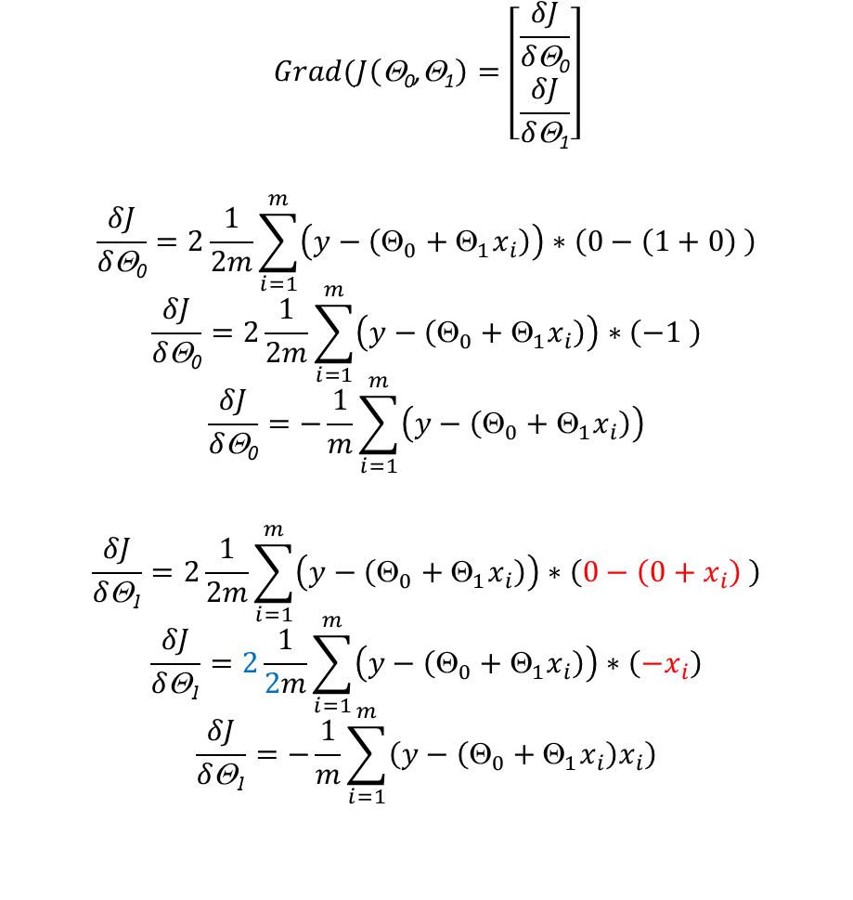
Computing Derivatives
$$Grad(J\left(\text{Θ}\text{0}\text{,}\text{Θ}\text{1}\right)=\left[\begin{matrix}\frac{δJ}{δ\text{Θ}\text{0}} \\ \frac{δJ}{δ\text{Θ}\text{1}}\end{matrix}\right]$$
$$\frac{δJ}{δ\text{Θ}\text{0}}=2\frac{1}{2m}\sum_{i=1}^{m}{\left(y−\left(Θ_{0}+Θ_{1}x_{i}\right)\right)∗\left(0−\left(1+0\right) \right)}$$
$$\frac{δJ}{δ\text{Θ}\text{0}}=2\frac{1}{2m}\sum_{i=1}^{m}{\left(y−\left(Θ_{0}+Θ_{1}x_{i}\right)\right)∗\left(−1 \right)}$$
$$\frac{δJ}{δ\text{Θ}\text{0}}=−\frac{1}{m}\sum_{i=1}^{m}{\left(y−\left(Θ_{0}+Θ_{1}x_{i}\right)\right)}$$
$$\frac{δJ}{δ\text{Θ}\text{1}}=2\frac{1}{2m}\sum_{i=1}^{m}{\left(y−\left(Θ_{0}+Θ_{1}x_{i}\right)\right)∗\left(0−\left(0+x_{i}\right) \right)}$$
$$\frac{δJ}{δ\text{Θ}\text{1}}=2\frac{1}{2m}\sum_{i=1}^{m}{\left(y−\left(Θ_{0}+Θ_{1}x_{i}\right)\right)∗\left(−x_{i}\right)}$$
$$\frac{δJ}{δ\text{Θ}\text{1}}=−\frac{1}{m}\sum_{i=1}^{m}{\left(y−\left(Θ_{0}+Θ_{1}x_{i}\right)x_{i}\right)}$$
Hypothesis:
h_{Θ}(x)= Θ₀ + Θ₁x
Parameters:
Θ₀, Θ₁
Cost:
$$J\left(\text{Θ}\text{0}\text{,Θ}\text{1}\right)=\frac{1}{2m}\sum_{i=1}^{m}{{\left(\text{y}\text{i}\text{−}\text{h}\text{Θ}\text{(}\text{x}\text{i}\text{)}\right)}^{2}}$$
$$J\left(\text{Θ}\text{0}\text{,}\text{Q}\text{1}\right)=\frac{1}{2m}\sum_{i=1}^{m}{{\left(y−\left(Θ_{0}+Θ_{1}x_{i}\right)\right)}^{2}}$$
Goal:
minimize J(Θ₀,Θ₁)

Slide 45
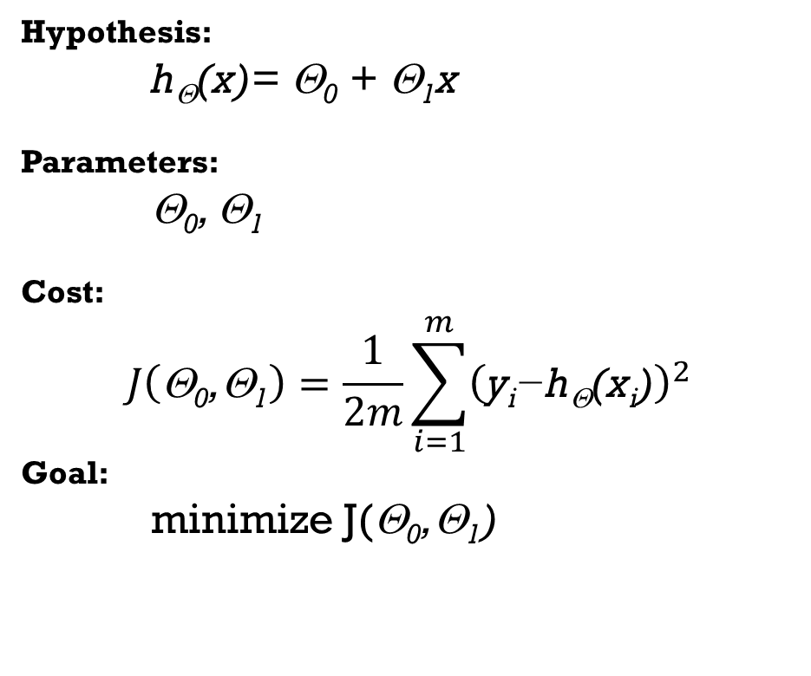
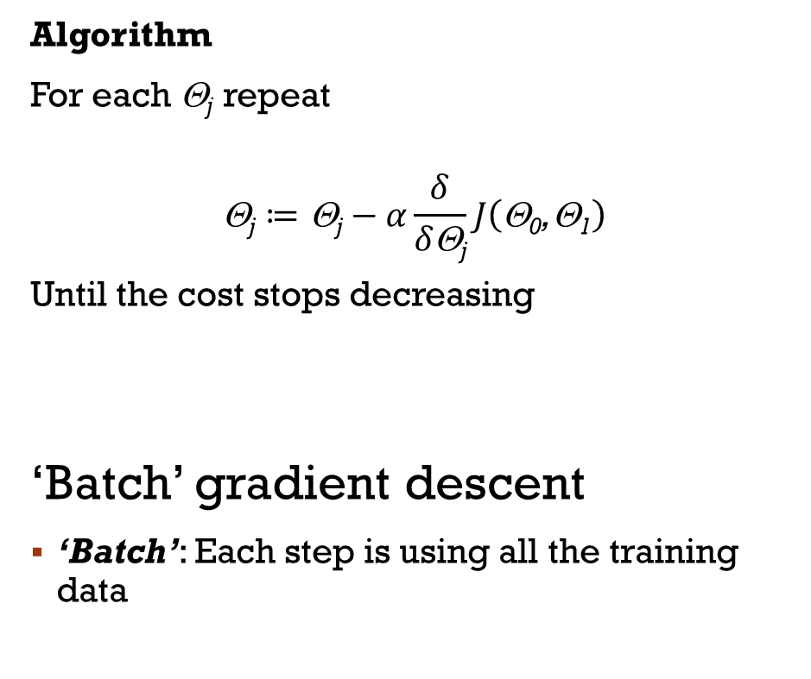
Linear Regression - Summary
Hypothesis:
h_{Θ}(x)= Θ₀ + Θ₁x
Parameters:
Θ₀, Θ₁
Cost:
$$J\left(\text{Θ}\text{0}\text{,Θ}\text{1}\right)=\frac{1}{2m}\sum_{i=1}^{m}{{\left(\text{y}\text{i}\text{−}\text{h}\text{Θ}\text{(}\text{x}\text{i}\text{)}\right)}^{2}}$$
Goal:
minimize J(Θ₀,Θ₁)
Algorithm
For each Θ_{j} repeat
$$\text{}\text{j}≔\text{}\text{j}−α\frac{δ}{δ\text{}\text{j}}J\left(\text{}\text{0}\text{,}\text{1}\right)$$
Until the cost stops decreasing
‘Batch’ gradient descent
‘Batch’: Each step is using all the training data

Slide 46
Linear Regression – Using many Inputs

Slide 47
Why do we need Multiple inputs?
Labels are usually not a function of single input.
Using multiple inputs it is possible to improve the model accuracy
X₁ (area) | Y (price)
65.75 | 504
64.21 | 453.6
71.85 | 728.7
69.98 | 701.4
71.47 | 760.2

Slide 48
Why do we need Multiple inputs?
Labels are usually not a function of single input.
Using multiple inputs it is possible to improve the model accuracy
X₁ (area) | X₂ (number of rooms) | Y (price)
65.75 | 3 | 504
64.21 | 4 | 453.6
71.85 | 4 | 728.7
69.98 | 4 | 701.4
71.47 | 5 | 760.2

Slide 49
Why do we need Multiple inputs?
Labels are usually not a function of single input.
Using multiple inputs it is possible to improve the model accuracy
X₁ (area) | X₂ (number of rooms) | X₃ (crime rate) | Y (price)
65.75 | 3 | 1.2 | 504
64.21 | 4 | 3.1 | 453.6
71.85 | 4 | 3.2 | 728.7
69.98 | 4 | 2.2 | 701.4
71.47 | 5 | 1.5 | 760.2

Slide 50
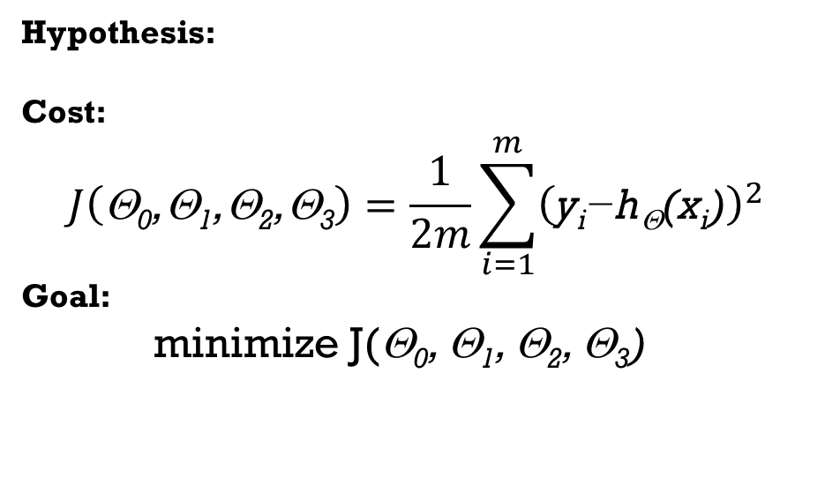
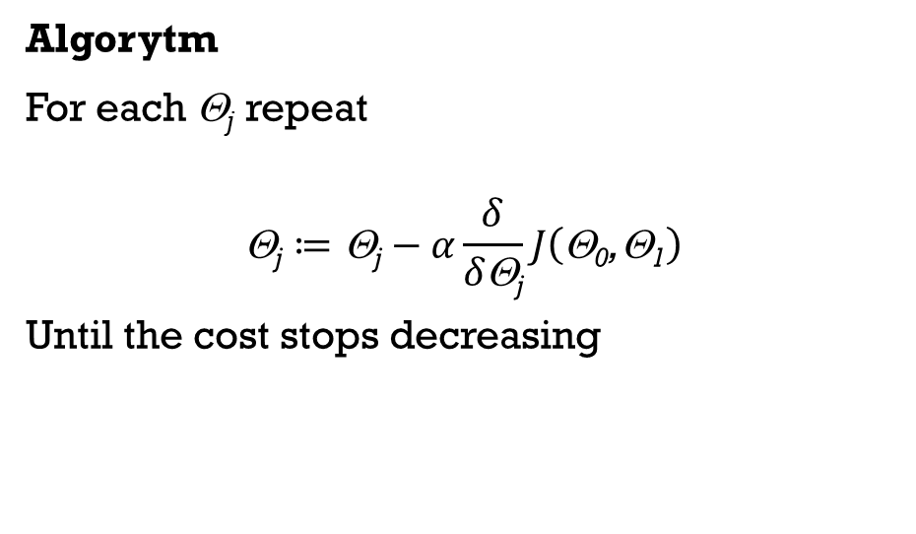
Algorytm
X₁ | X₂ | X₃ | Y
65.75 | 3 | 1.2 | 504
64.21 | 4 | 3.1 | 453.6
71.85 | 4 | 3.2 | 728.7
69.98 | 4 | 2.2 | 701.4
71.47 | 5 | 1.5 | 760.2
Hypothesis:
Cost:
$$J\left(\text{}\text{0}\text{,}\text{1}\text{,}\text{2}\text{,}\text{3}\right)=\frac{1}{2m}\sum_{i=1}^{m}{{\left(\text{y}\text{i}\text{−}\text{h}\text{}\text{(}\text{x}\text{i}\text{)}\right)}^{2}}$$
Goal:
minimize J(Θ₀, Θ₁, Θ₂, Θ₃)
Algorytm
For each Θ_{j} repeat
$$\text{}\text{j}≔\text{}\text{j}−α\frac{δ}{δ\text{}\text{j}}J\left(\text{}\text{0}\text{,}\text{1}\right)$$
Until the cost stops decreasing

Slide 51
Linear Regression – NonLinearity

Slide 52


Nonlinearity - Why?
Price
Price
Area
Area

Slide 53
Nonlinearity - Why?
Inputs -> labels relation does not have to be linear
Nonlinearity may improve the accuracy of the model
X₁ (area) | Y (price)
65.75 | 504
64.21 | 453.6
71.85 | 728.7
69.98 | 701.4
71.47 | 760.2

Slide 54
Nonlinearity - Why?
Inputs -> labels relation does not have to be linear
Nonlinearity may improve the accuracy of the model
X₁ (area) | X₂ (area²) | Y (price)
65.75 | 4323.063 | 504
64.21 | 4122.924 | 453.6
71.85 | 5162.423 | 728.7
69.98 | 4897.2 | 701.4
71.47 | 5107.961 | 760.2

Slide 55


Algorytm
X₁ | X₂ | Y
65.75 | 4323.063 | 504
64.21 | 4122.924 | 453.6
71.85 | 5162.423 | 728.7
69.98 | 4897.2 | 701.4
71.47 | 5107.961 | 760.2
Hypothesis:
h_{Θ}(x)= Θ₀ + Θ₁x₁ + Θ₂x₂
Parameters:
Θ₀, Θ₁, Θ₂
Cost:
$$J\left(\text{Θ}\text{0}\text{,Θ}\text{1}\text{,Θ}\text{2}\right)=\frac{1}{2m}\sum_{i=1}^{m}{{\left(\text{y}\text{i}\text{−}\text{h}\text{Θ}\text{(}\text{x}\text{i}\text{)}\right)}^{2}}$$
Goal:
minimize J(Θ₀, Θ₁, Θ₂)
Algorithm
For each Θ_{j} repeat
$$\text{}\text{j}≔\text{}\text{j}−α\frac{δ}{δ\text{}\text{j}}J\left(\text{}\text{0}\text{,}\text{1}\right)$$
Until the cost stops decreasing

Slide 56
Nonlinearity and the number of features
Two input features, Hypothesis: second order polynomial
Non Linear hypothesis: x₁, x₂
Linear hypothesis: h_{Θ}(x)= Θ₀ + Θ₁x₁ + Θ₂x₂
Nonlinear hypothesis : h_{Θ}(x)= Θ₀ + Θ₁x₁ + Θ₂x₂ + Θ₃x₁² + Θ₄x₂² + Θ₅x₁x₂
Three input features, Hypothesis: third order polynomial
Inputs: x₁, x₂, x₃
Linear hypothesis: h_{Θ}(x)= Θ₀ + Θ₁x₁ + Θ₂x₂ + Θ₃x₃
Nonlinear hypothesis: h_{Θ}(x)= Θ₀ + Θ₁x₁ + Θ₂x₂ + Θ₃x₃ + Θ₄x₁³ + Θ₅x₂³ + Θ₆x₃³
+Θ₇x₁²x₂ +Θ₈x₁²x₃+Θ₉x₂²x₁ +Θ₁₀x₂²x₃+Θ₁₁x₃²x₁ +Θ₁₁x₃²x₂ + Θ₁₂x₁x₂x₃
+Θ₁₃x₁² +Θ₁₃x₂²+Θ₁₄x₃² +Θ₁₅x₁x₂+Θ₁₆x₁x₃ +Θ₁₇x₂x₃

Slide 57




Vector Notation
$$\overset{⃑}{X}=\left[\begin{aligned}x_{0} \\ x_{1} \\ x_{2} \\ x_{3} \\ x_{4} \\ x_{5}\end{aligned}\right]$$
$$\overset{⃑}{\text{}}=\left[\begin{aligned}{\text{}}_{0} \\ {\text{}}_{1} \\ {\text{}}_{2} \\ {\text{}}_{3} \\ {\text{}}_{4} \\ {\text{}}_{5}\end{aligned}\right]$$
Hypothesis: h_{Θ}(x)= Θ₀ + Θ₁x₁ + Θ₂x₂ + Θ₃x₃ + Θ₄x₄ + Θ₅x₅
Assume: x₀ = 1
Hypothesis: h_{Θ}(x)= Θ₀x₀ + Θ₁x₁ + Θ₂x₂+ Θ₃x₃+ Θ₄x₄ + Θ₅x₅
Vectorized hypothesis:
$$h_{\text{Θ}}(x)={\overset{⃑}{\text{Θ}}}^{T}\overset{⃑}{\text{X}}$$
$\left[{\text{}}_{0},{\text{}}_{1},{\text{}}_{2},{\text{}}_{3},{\text{}}_{4},{\text{}}_{5}\right]∗\left[\begin{aligned}x_{0} \\ x_{1} \\ x_{2} \\ x_{3} \\ x_{4} \\ x_{5}\end{aligned}\right]$=Θ₀x₀ + Θ₁x₁ + Θ₂x₂+ Θ₃x₃+ Θ₄x₄ + Θ₅x₅

Slide 58
Thank you Q & A

